Slide 1
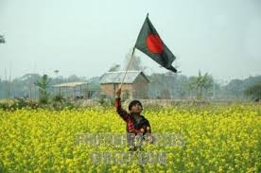
Wel come

Slide 2

students

Slide 3



INTRODUCE
MD.WALIULLAH ALAM
ASSISYANT TEACHER ID-25
CHORPALASH HIGH SCHOOL,PAKUNDIA, KISHOREGANJ.
MOB-01736000126
E_mail:alamchs@gmail.com
CLASS-NINE
UNIT_3 LESSON_5
SUBJJECT-ENGLISH

Slide 4
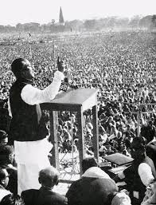
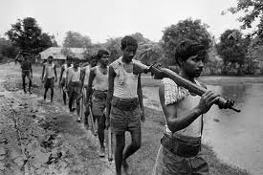
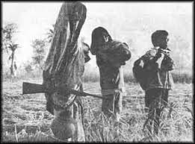
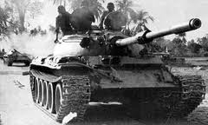
LIBERATION WAR PICTURE

Slide 5
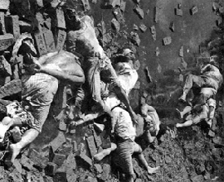
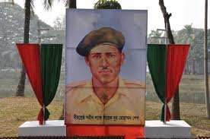
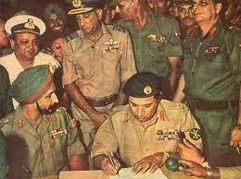
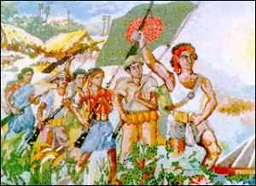
LIBERATION WAR PICTURE

Slide 6
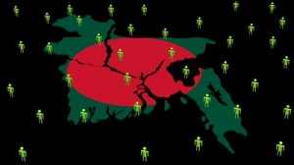
Independence day

Slide 7


Learning outcomes
After we have studied this lesson,we will be able to….
1.Talk about the national memorial.
2.Talk about independence festival.
3.Know about liberation war.
4.Infear meaning from the context.

Slide 8
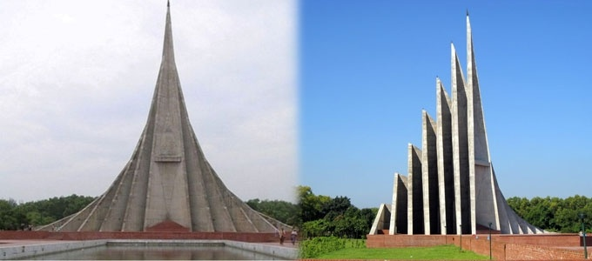

National memorial

Slide 9
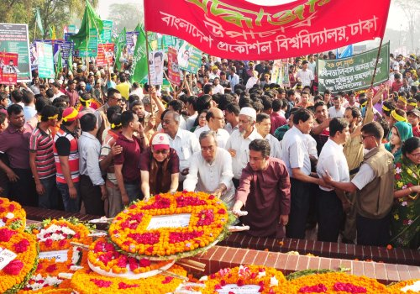
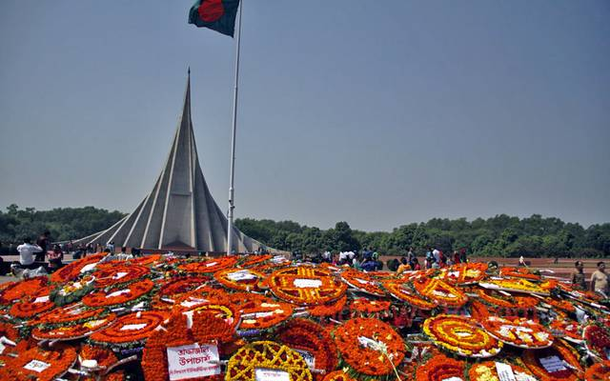

26march picture

Slide 10
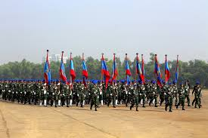
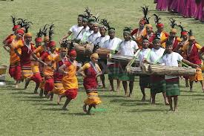
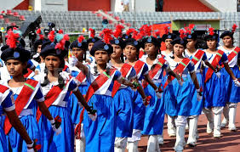
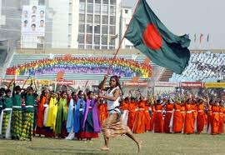
VARIOUS DISPLAY

Slide 11

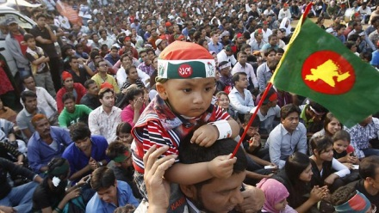
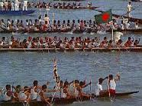

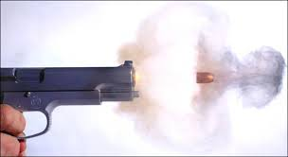
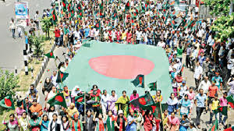

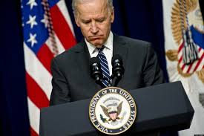
VOCABULARY
spectators
দর্শক
Boat race
নৌকা বাইচ প্রতিযোগিতা
Gunshots
তোপধধনি
Processions
সমাবেশ
Diplomats
কূটনৈতিক

Slide 12
GROUP WORK
Draw a picture on the national memorial.
Write a paragraph use this clues text below:
Celebrated,gunshots,cultural programmes,spectators,illuminated.

Slide 13


SINGLE WORK
Write synonym:
Festival
Organization
Memorial
Displays
Illuminate
celebration
institution
mausoleum
exhibits
enlighten

Slide 14

EVALUATION
1.What is the biggest state festival in Bangladesh?
2.How does begin this day?
3.Who arrange cultural functions?
4.Why people go to the national Mausoleum?
5.What do you mean VDP?

Slide 15
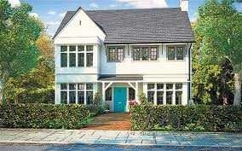
Home work
write,in brief,how you celebrated this year’s independence day at your school.

Slide 16

No more today

